Slide 2
Sprout-Scout
Bearingpoint written dossier
Startup Concept
Peter Grüner, Simon Wild

Slide 3
Mission & Vision
Sprout Scout - We fertilize your Career
Mission Statement:
“Sprout-Scout is a startup which helps students define their professional future, makes the perfect match of their personalized profiles with the job market and therefore plants the seeds in the ideal environment for fast development.”
Vision Statement:
“We want to be the mass-customization platform for todays gig-economy. By analyzing every single user and making the perfect match with open positions we aim to become the worlds largest employer without any staff.
Our Big-Five goals:
No unintended unemployment
Equal, performance-based development opportunity's for every terrestrial
Enable situational flexibility to every human being
Empower business agility for all our members
Eliminate occupational disease due to optimized work-life-balance

Slide 4
Business Model Canvas

Slide 5
Goal and Value Proposition
What do you want to achieve with your project? How do you generate added value for customers, society or/and the environment? Can you describe your product/service?
Easy to use platform for employers and employees
Two-Sided Marked
customized work-life-balance
enable professional self-fulfillment
flexibility
insights into the infinite job-market
kick-start career
High-skilled employees
Fight brain-drain

Slide 6








Value Proposition of Sprout-Scout
Kick-start
career
Platform
The sprouts are ready to grow in the right environment and to develop their branches further. With the right match between the incubator and the sprout a fast growth can be achieved.
With the platform business approach it is possible to achieve an asymmetric growth throw different industries, to use the network effect to connect the best candidates with the most promising job offers and use the distribution power to create exiting customer journeys for our partners.
Sprout Scout
High skilled Employees
Convenience
Every year about 40'000 students complete their studies in Switzerland and are highly motivated and well trained to apply their skills in real life environment.
Through our automated operations and the easy to use selection process we are the convenient solution to increase agility and flexibility for both, our sprouts and incubators.

Slide 7
Value Proposition compared to compatitors
Name | Reach | Scalability | Customer centricity | Convinience
Sprout-Scout
Coople
Adecco
4-Insiders

Slide 8
Marked Overview

Slide 9
Growth Process for Sprouts
01
02
03
04
University
Internship
Permanent Position
Giving Back
In the university the sprouts develop their skills and can hardly wait to apply them in the real world.
During internships, the sprouts can use their skill toolbox and it will become clear in which direction they want to develop. The incubator plays a central role for the development.
The sprouts have grown to a stage where they can develop further skills in their field of intersts which are benefical for the incubator as well as for themselves.
A sprout will always develop further and will eventually carry fruits for us in the form of new internship positions and allow new sprouts to develop in the same incubator.

Slide 10
Target Group, Market
For whom have you created your project, product or service? What are size and characteristics of your target group?
Multi-sided platform, niche marked
In a first phase the business model focuses on an niche marked
It focuses only on Students which are seeking for internships.

Slide 11




Value Creation
Customer Relationship, Distribution and Customer Segments
Value Creation
Customer Relationship
Channels / Distribution
Customer Segment
Personalizes Service
Career Fairs
Personal Presentation
Automated Services
Digital Marketing Strategy
Mobile- and Webservices
Search Engine Optimization
Google Add works
Niche Marked (Sprouts)
Students / young adults
Mobile Application
Responsive Website
Mass-market (Incubators)
Small and Medium Sizes Enterprises
Big Companies

Slide 12
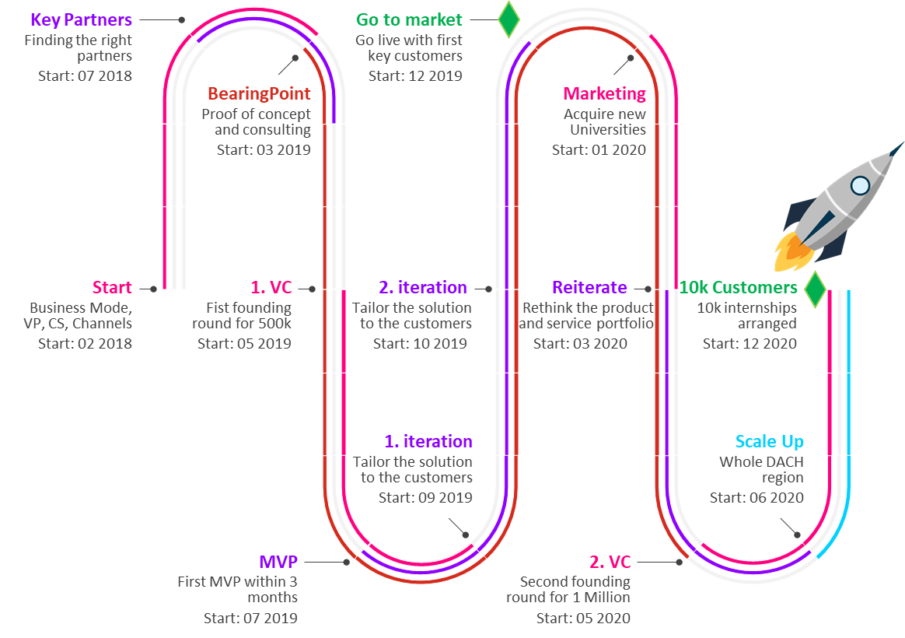
Time Line
Start with the ideas and the Business Model Canvas
Searching for Start Up Partner and programing power
BearingPoint challenge and proof of concept
First founding round to finance the MVP
Design thinking sessions with different customer segments
Go to market with the first working product and gather more real life feedback
Digital marketing strategy, personalized acquisition of other university's.
Reiterate the current product with his processes and servieces acording to the feedback
Sencond round of founding for a faster expandion strategie
Scaling process to other countries
First 10’000 customers by dezember 2020

Slide 13
Organization
What resources do you need for the implementation of your project? What activities and processes need to be set-up to achieve added value from your project?
MVP, Programing Know-How and Working space
First of all an MVP has to be created.
With the MVP a first iteration of the platform and the matching algorithm can be done.
The Customers can give feedback to the interface and provide valuable insides in possible mistakes on the design and operations.
A Database and the matching algorithm have to be created.
Collaboration with Universities and Companies have to be established.

Slide 14
BearingPoint’s role
Supporter in the development phase and connector to various companies
With the large network of BearingPoint a faster penetration of the market can be achieved.
With the already established connection with different companies, BearingPoint can help to grow the job-offer side of the platform with different companies and possibly themselves.
The Know-How of various industry's of BearingPoint can help us to develop the right assessments for the jobseekers to match them with the right employer and job.
Each industry has different requirements for their employees in regards to culture, skill and know-how.
Proof of Concept
BearingPoint as a lot of experts in different industries and a wide range of know-how in different fields. With the approval of an expert team the concept can be perceived as good and the search for venture capitalists should be easier.

